Slide 1
Boxer punch classification
Plan:
Problem analysis Data collection Data analysis Model of classification of individual punches Model of search for punches during bout
Speaker: Rudchyk Vladyslav

Slide 2
Task
Create a system that will highlight and classify the boxer's punches during training (training combat and individual punches)
For this purpose it is necessary to:
Come up with a system with which you will collect data
Collect dataset
Analyze the data obtained
Complete the data processing
Create a machine learning model that will highlight and classify punches
Test and analyze the results

Slide 3
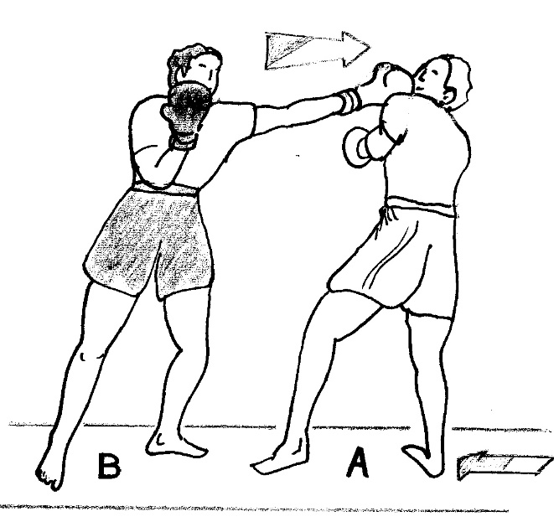
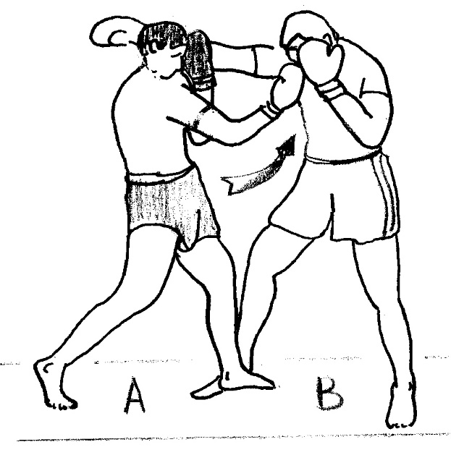
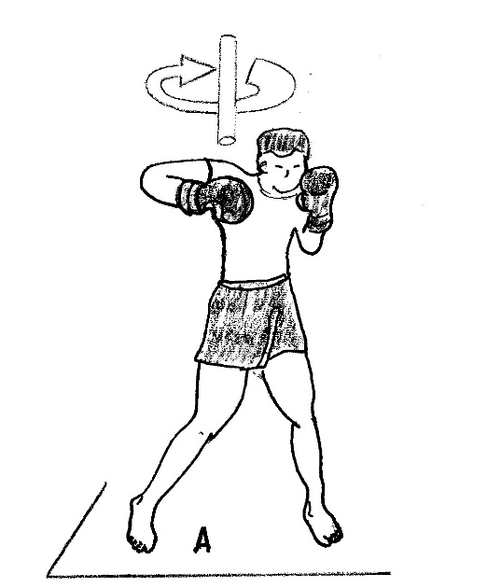
Problem analysis
Jab
Uppercut
Hook
Assumption: Each punch type has a unique movement technique => Thus, there must be a dependence on the angle of rotation and range of these angles during the certain punch => Add gyroscope to sensors
I decided to break down into the model into two parts. First one will classify the punches, the second one will detect them in signal.

Slide 4
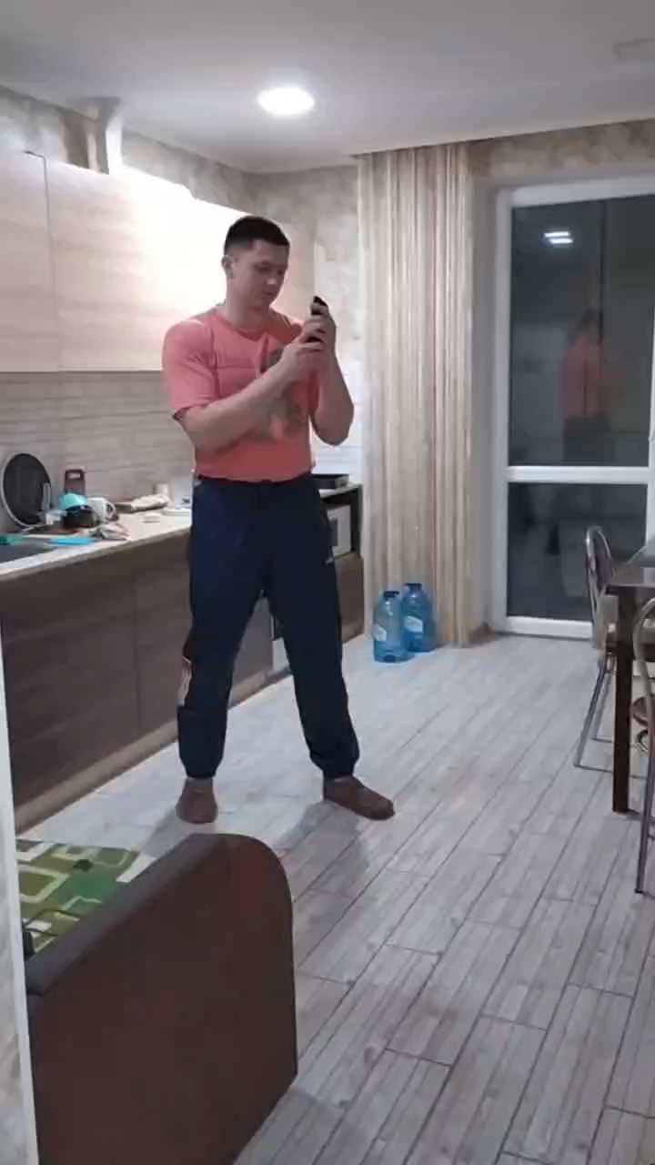
Data collection
Sensors: Accelerometer and Gyroscope in the phone (accuracy, frequency and measurement area)
Position: in the hand, perpendicular to the fingers, the screen towards you, the camera towards the thumb.
9 (7+2 only test) professional fighters with a well placed punch in the data collection.
There are 2 types of records:
Systems of successive separate clean strokes of different speeds and made by different hands.
A shadow fight in which boxers could move freely, use counters and parry, only 3 types of punches could be used
A total of 33 recordings (550 punches) of the first type, 15 recordings (12 min, 250 punches) of the second type were collected.
Example of the training fight

Slide 5
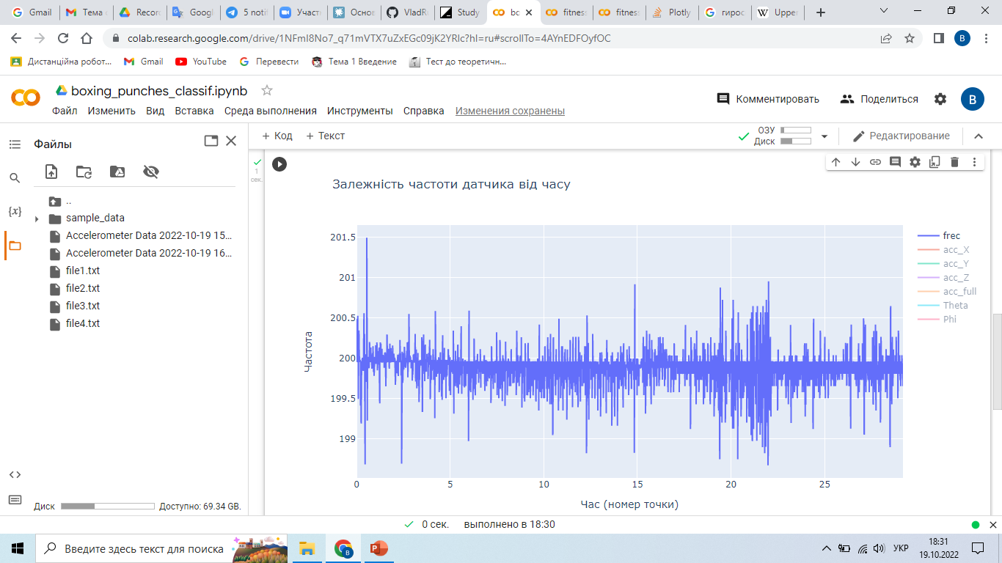
We have a stable frequency of the sensor in the selected range.
Max deviation +-2 Hz.
Data analysis

Slide 6
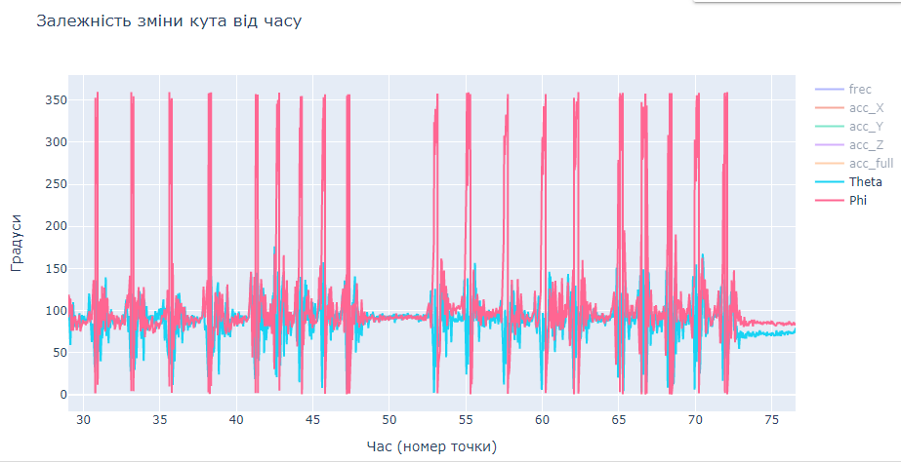
There were no failures and abnormal values in the viewed files.
Data analysis

Slide 7
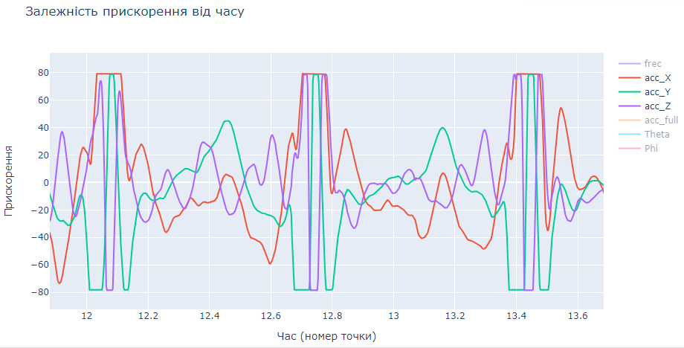
Pugilists have very fast and hard punches, which can exceed accelerometers max detected value of 8g.
Data analysis

Slide 8
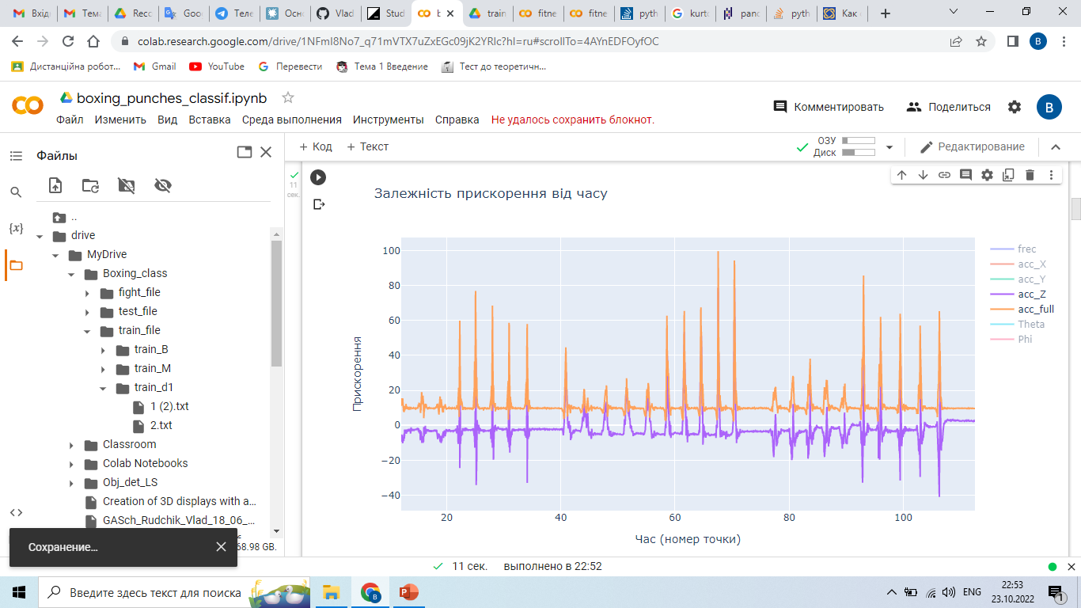
As it turned out, the file has a maximum size, and therefore the whole workout does not fit into one file, you have to divide it into parts.
Data analysis

Slide 9
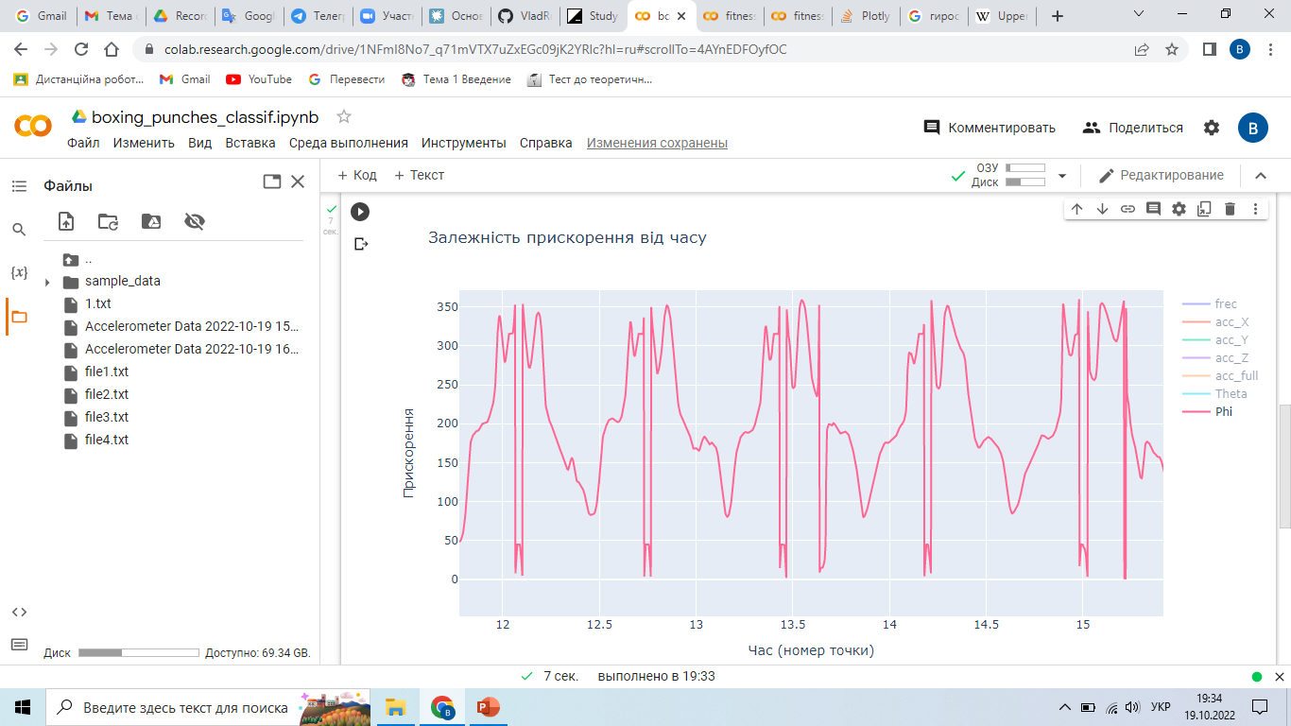
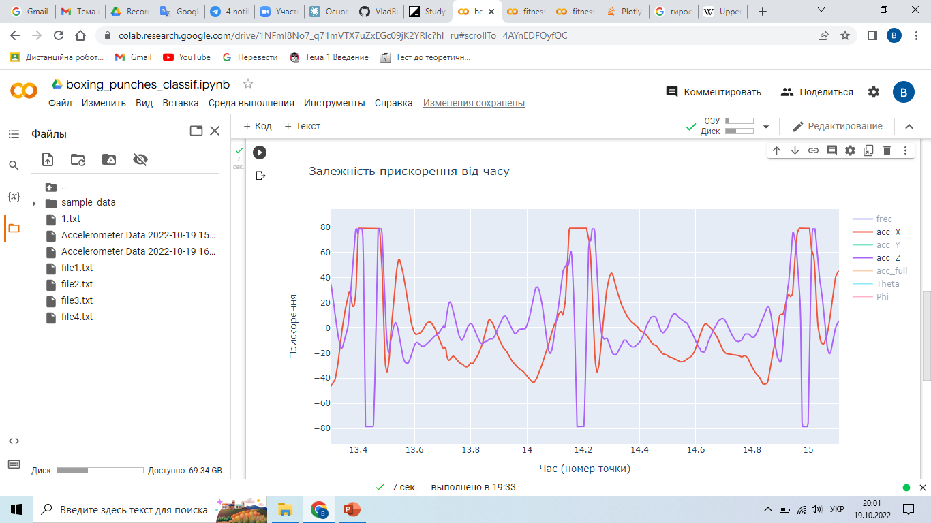
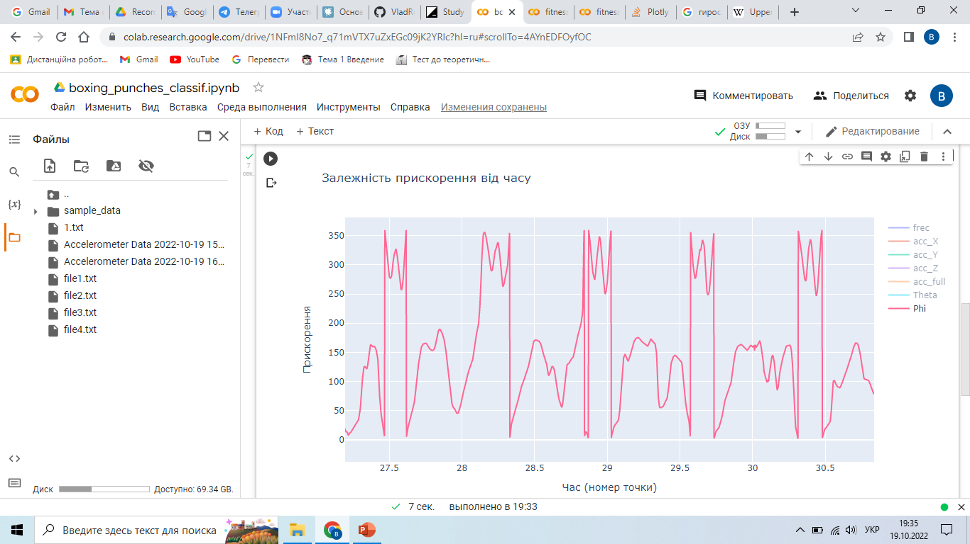
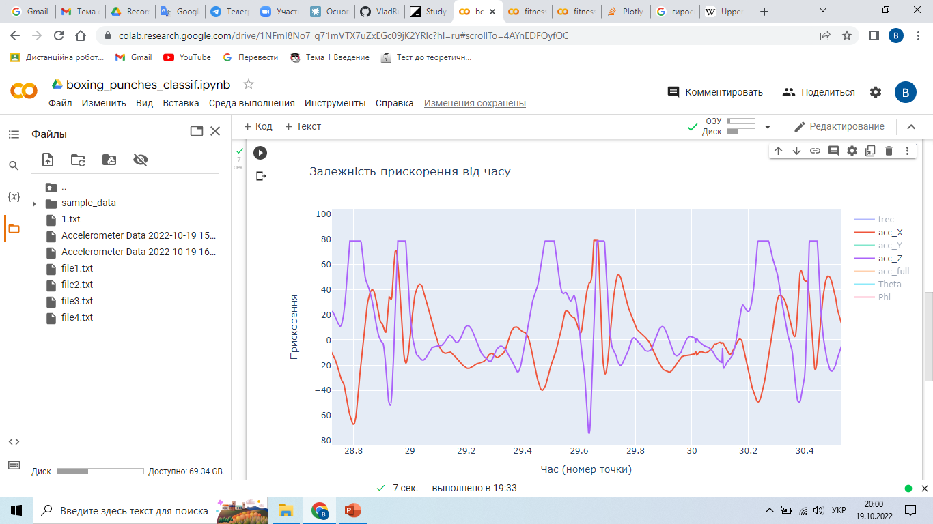
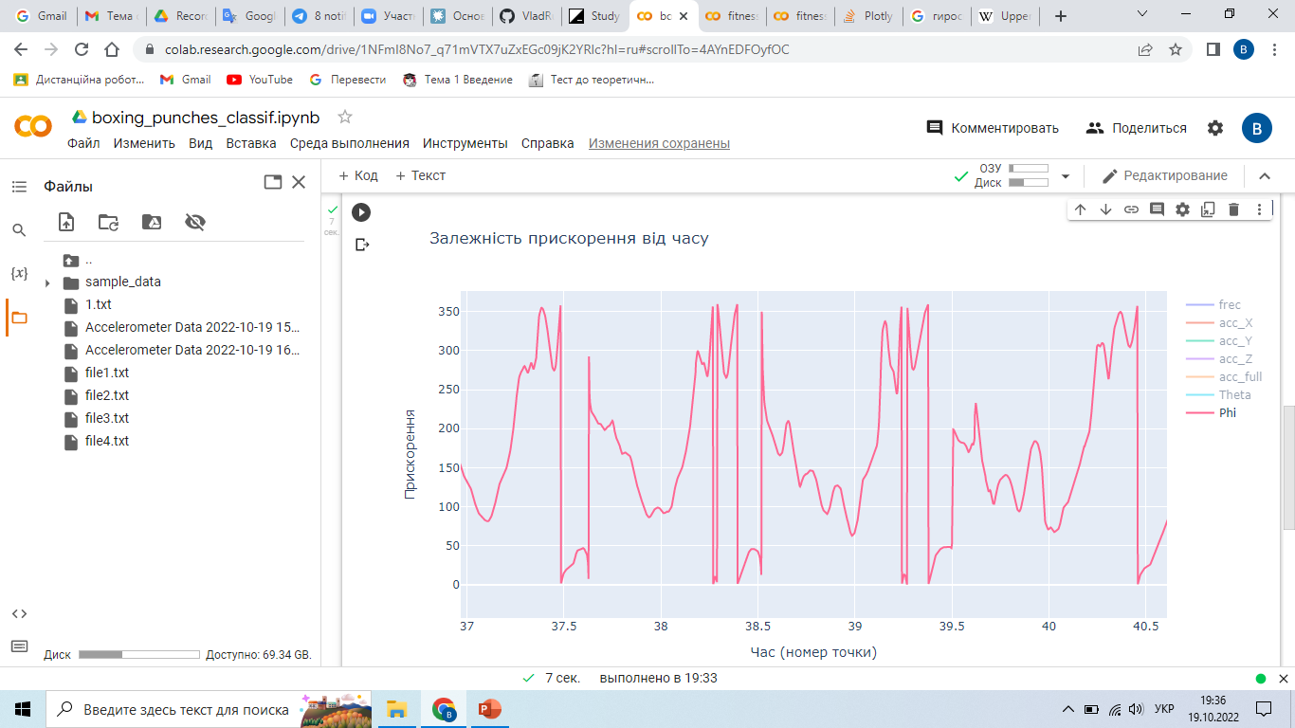
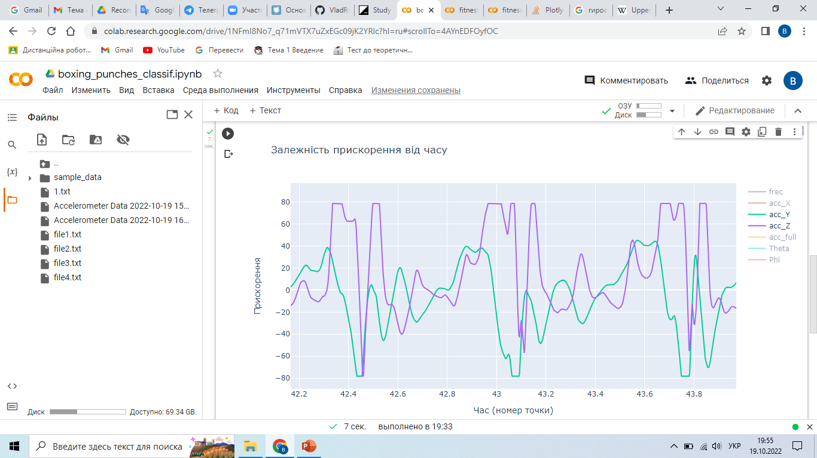
Jab
Gyroscope
Accelerometer
Uppercut
Gyroscope
Accelerometer
Hoоk Accelerometer
Accelerometer

Slide 10
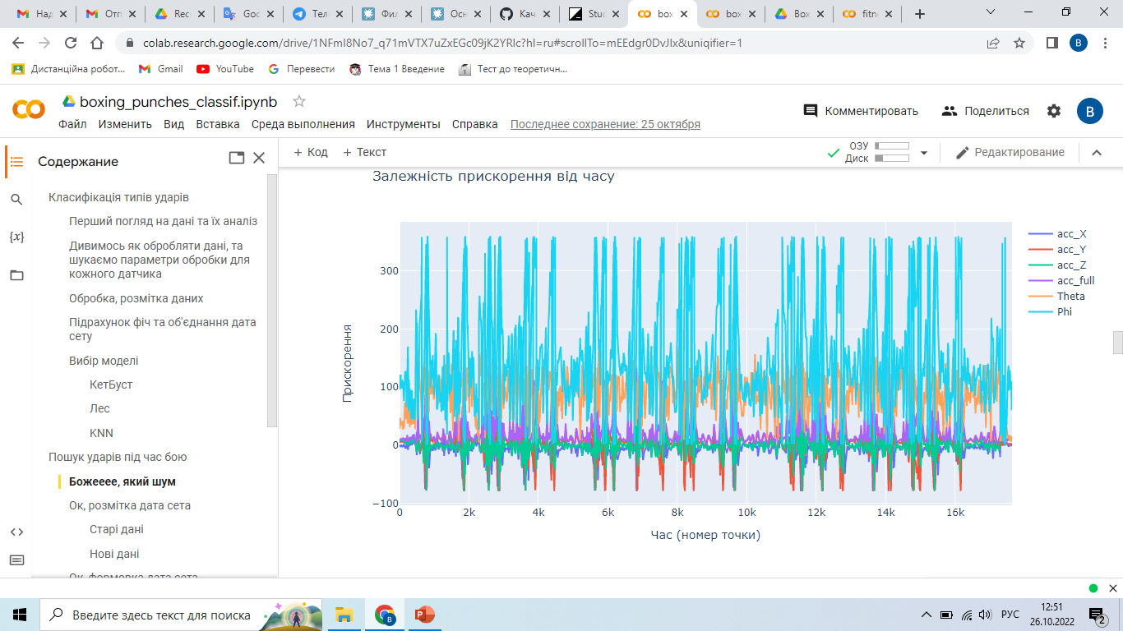
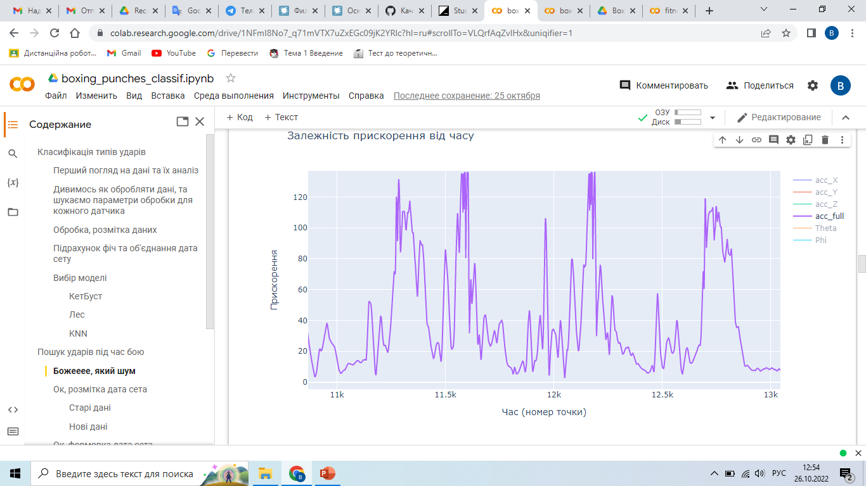
An example of battle data. Considering all of the above, the data is good.
But there are obvious problems with noise.

Slide 11
Data analysis
Conclusion:
Stable recording frequencies (200/400 Hz), missing artifacts and anomalies => well-tuned and working sensors. Professional boxers have very fast punches, sometimes the maximum acceleration can be exceeded by (8g). There may be problems, but for now we are working. Be careful, with maximum size of the file. The beats have unique distributions that you can try to describe with statistical features. We need to filter the data well. In general, the data is good for building a model, you can work further.

Slide 12
Data filtering
Ideas:
Use median filter to cut out the impulse noises, and then smooth it with an exponential filter => Everything worked out, but it shifted the signal a little and distorted (for the gyroscope) it.
Use median filter to cut out impulse noises and then smooth it with a Kalman filter => It showed the best result (both at the filtration stage and on the model), and we will use it.
Use Fourier to remove noises of certain frequencies (jumps and hand tremors) => It didn't work. It removes the part caused by jumps, but it distorts the signal seriously.

Slide 13
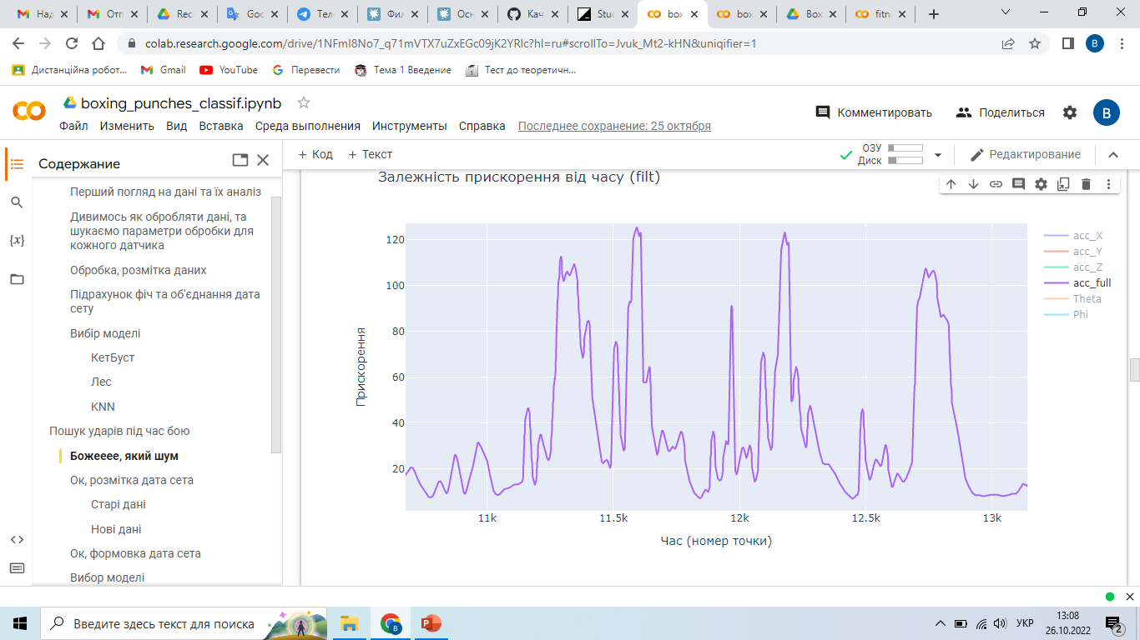
An example of a median filter and a Kalman method combination.

Slide 14
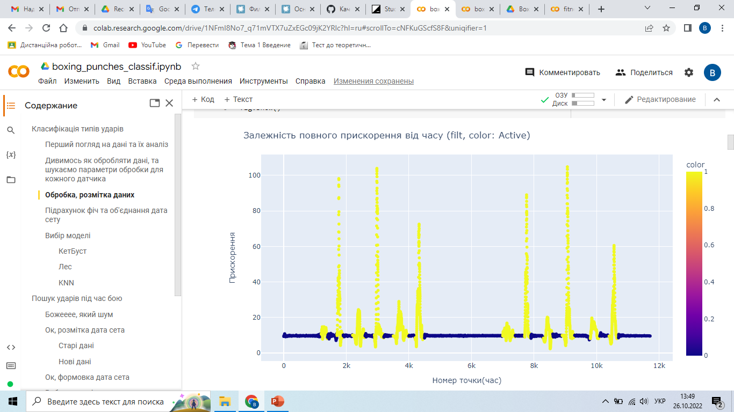
We break the signal into small buckets and determine the zones of rest and activity
Data preparation (model1)

Slide 15
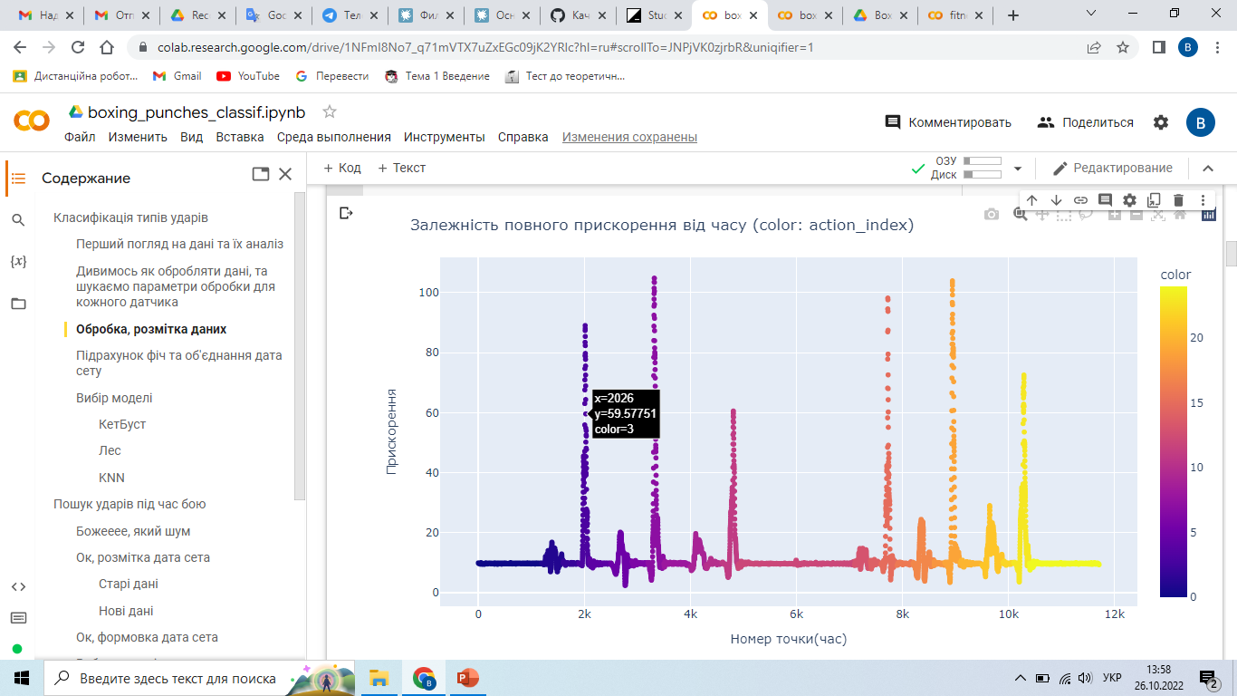
By changing the activity zone, we divide into separate actions.
Data preparation (m1)

Slide 16
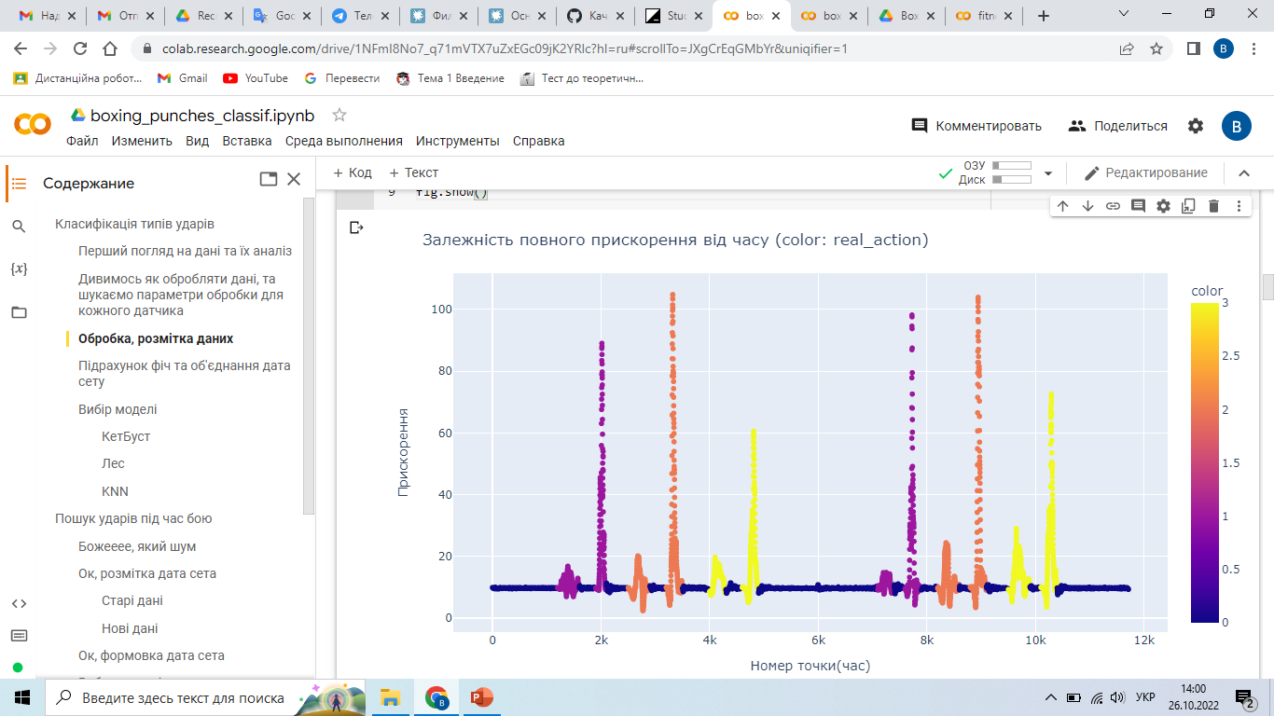
We mark the actions, remove the 0, count the features and submit them to the model.
Data preparation (m1)

Slide 17
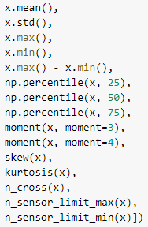
Statistical features
We calculate this set of stat features for each channel (accelerometer and gyroscope axes) for each bucket and get the dataset.

Slide 18
Results of the 1st model
Models: CatBoost, RandomForest, SVM, KNN.
CatBoost: roc_auc = 0.96, acc = 0.91 (66/72), errors were randomly distributed. It worked equally well with different types of punches (1/3/2), different hands (3/3), different punches speeds (4/2) and extrapolated well. RandomForest: similar to CatBoost, but roc_auc = 0.93, acc = 0.83 (61/72), KNN: roc_auc = 0.99, acc = 0.93 (67/72), but all the errors were in the data of people who were not in the training, the model did not extrapolate well. SVM: just gave bad results roc_auc = 0.82, acc = 0.73(55/72)

Slide 19
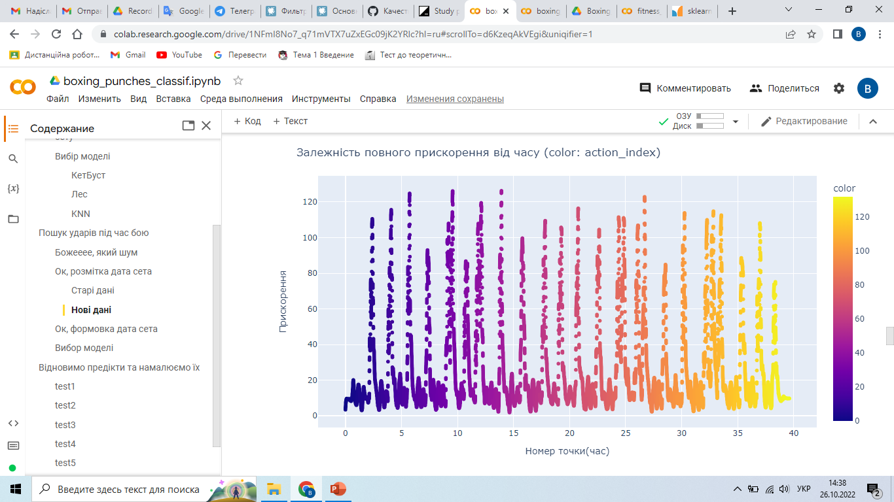
Break the signal down into small buckets (3-4 per blow)
Data preparation (model2)

Slide 20
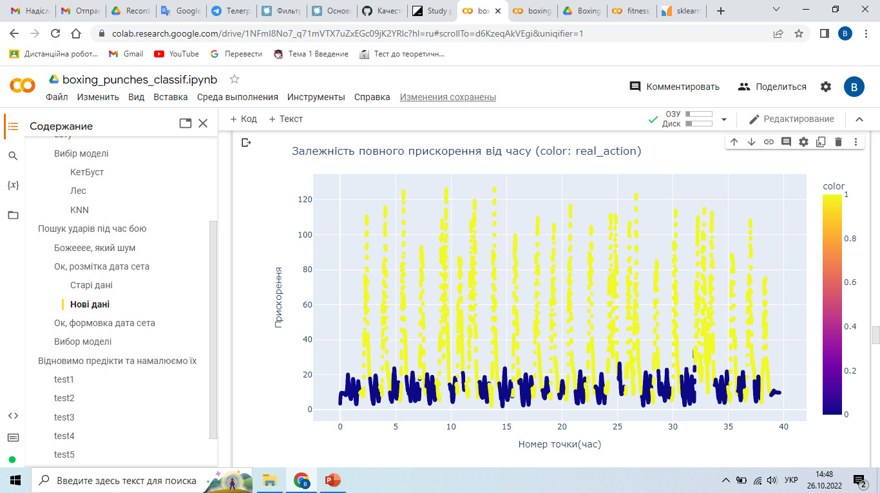
We mark the buckets, count the features and submit them to the model.
Data preparation (m2)

Slide 21
Results of the 2nd model
I tried teaching on 2 date sets: only fights, fights and first model data Models: CatBoost, RandomForest, SVM, KNN.
CatBoost: roc_auc = 0.99, precision = 0.98, recall = 0.97, most errors were in two cases:
These are not errors, but inaccuracies in the markup. If punches are slow, the model simply considered them noises.
In general, it showed good results, especially on the data of people who were not on the dataset.
Others: the types of errors are the same, but the results are worse.

Slide 22
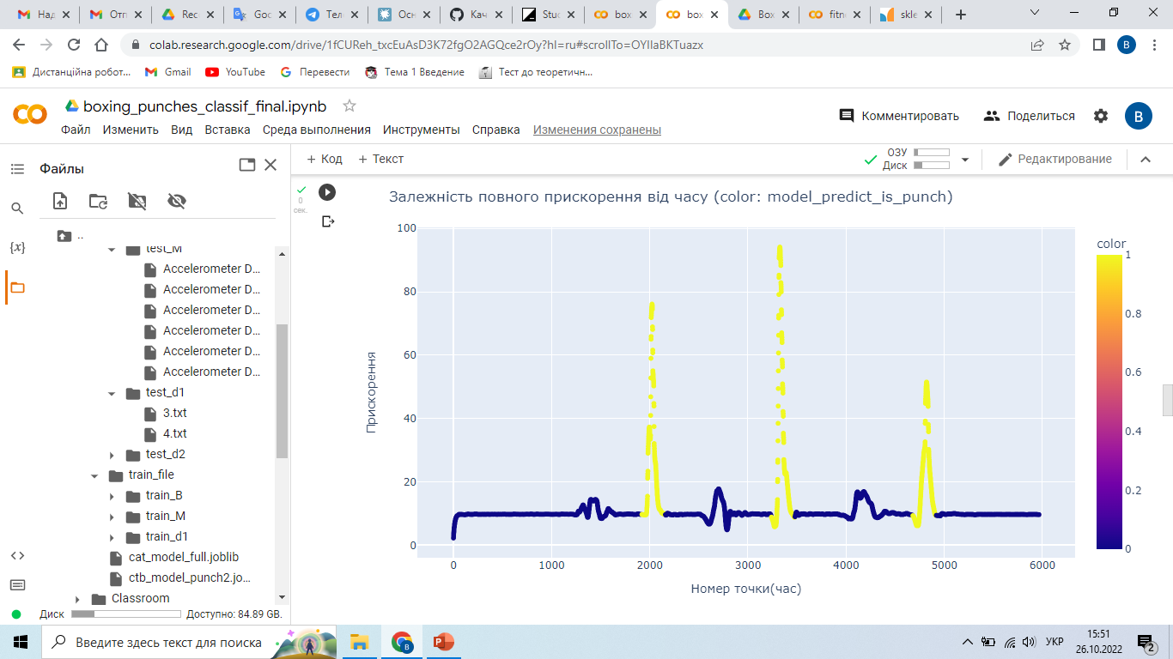
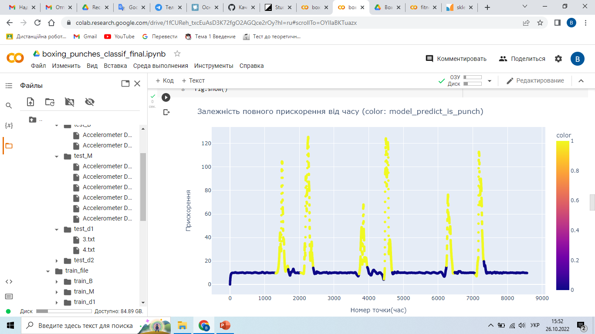
1. Error example of a very weak punch (acceleration max less than 2g)
2. Examples of poor markings where the model involved a punch, but this was not in the markup.

Slide 23
Combined model
We collect the buckets indicated in the second model in separate punches, list the features for individual punches, and submit them to the first model. Problem: if we had a double punch, and the model marked 2 strikes without breaking, then 2 punches pass as one.
In the end, the model takes raw data from 6 channels to the input, and gives detected and classified punches to the output. You can see this in the example on the 24th slide.
P.S. On the 25-29 slide, examples of the algorithm, above the predict, below the markup.
P.S.S. On slide 29, an example of the result for a person with a bad punch technique.

Slide 24
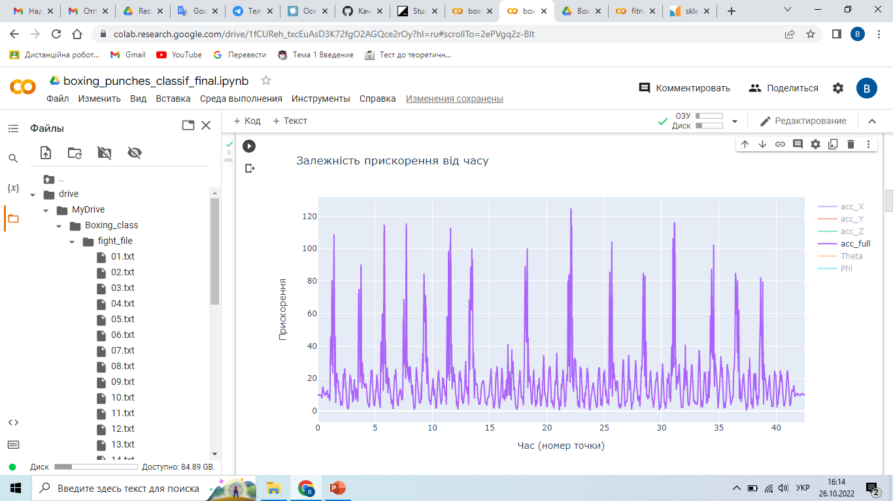
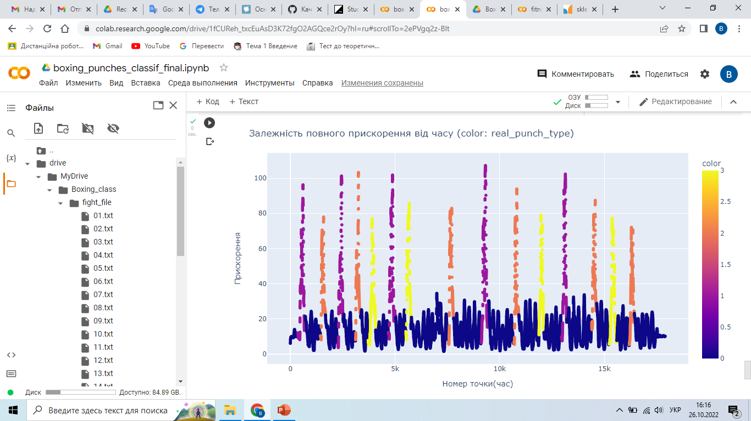

Slide 25
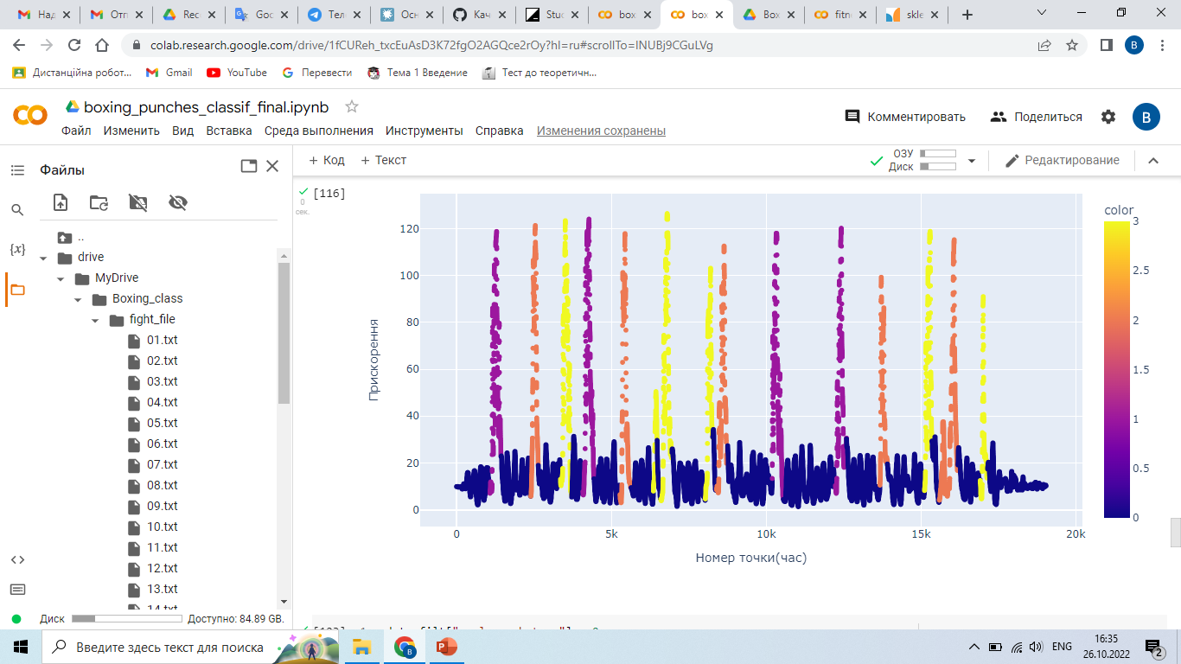
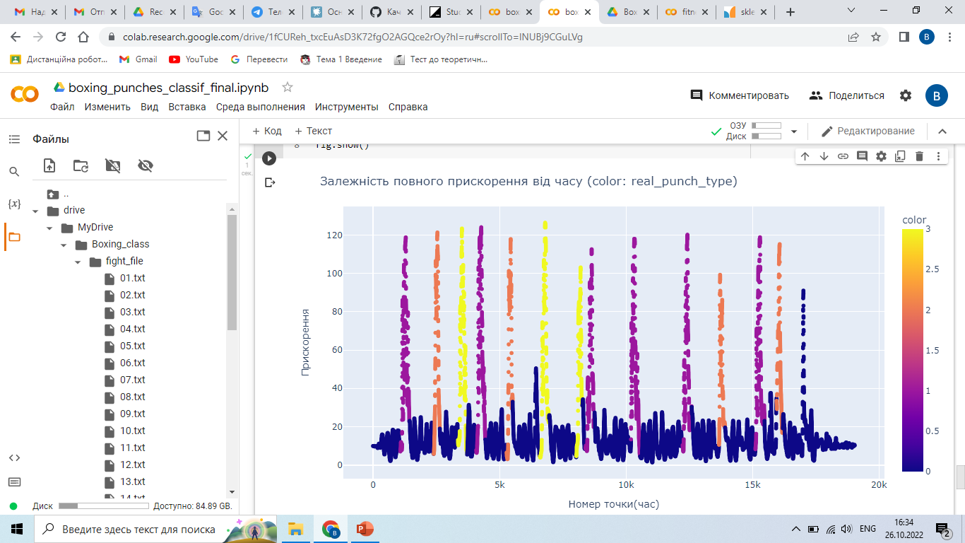

Slide 26
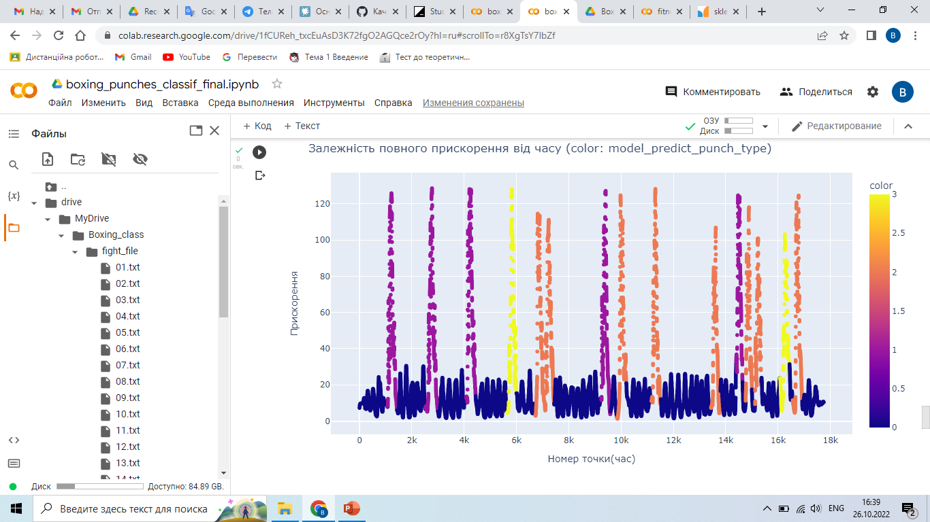
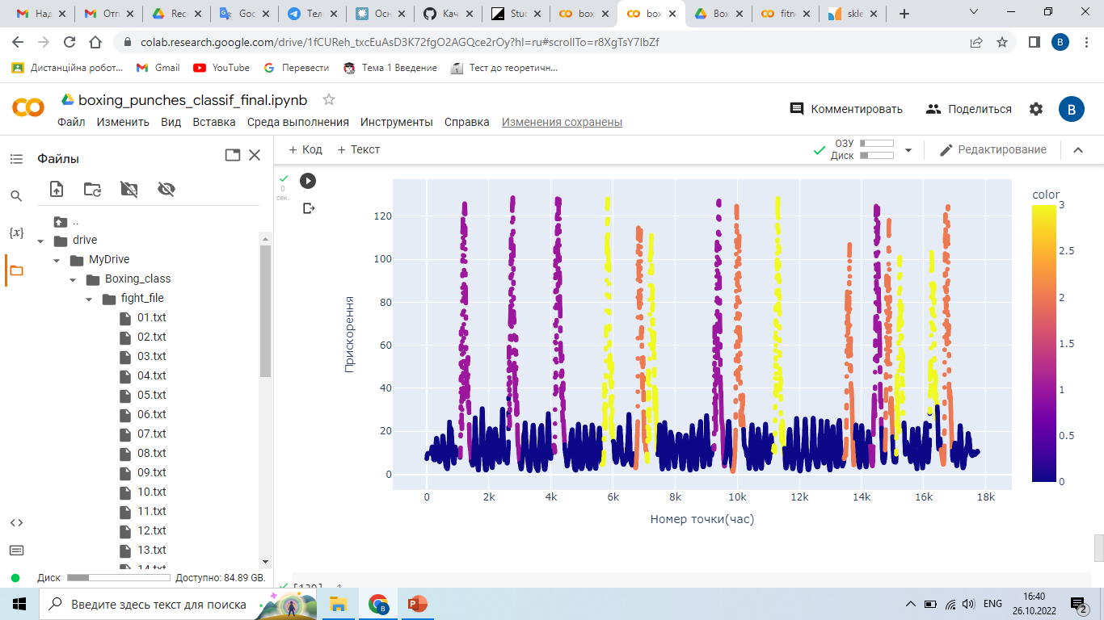

Slide 27
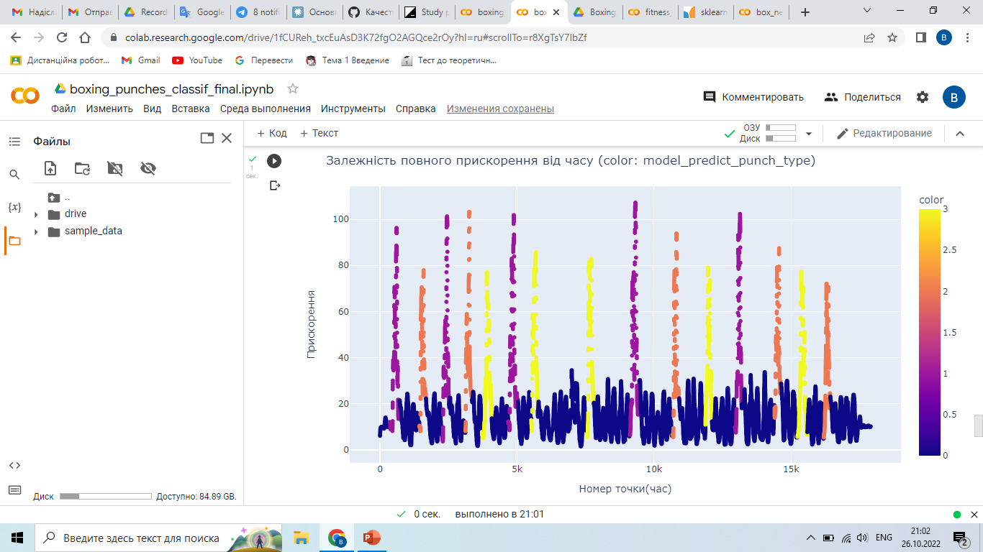

Slide 28
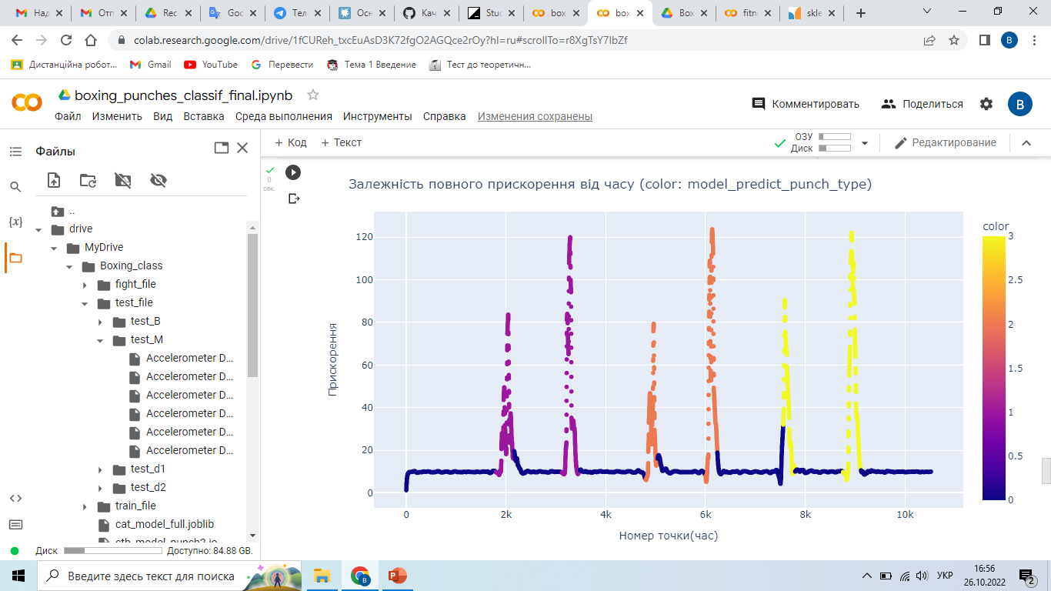
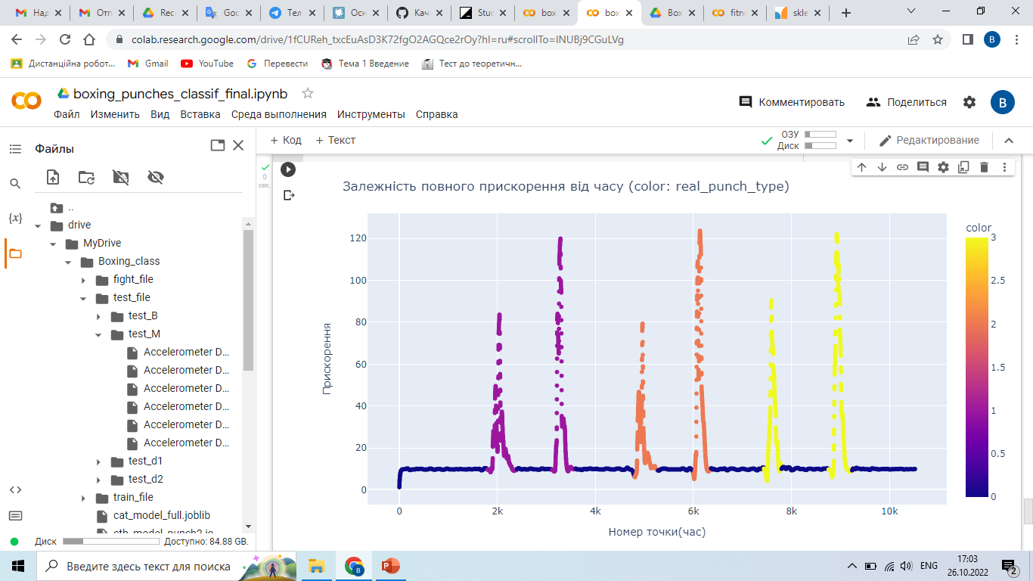

Slide 29
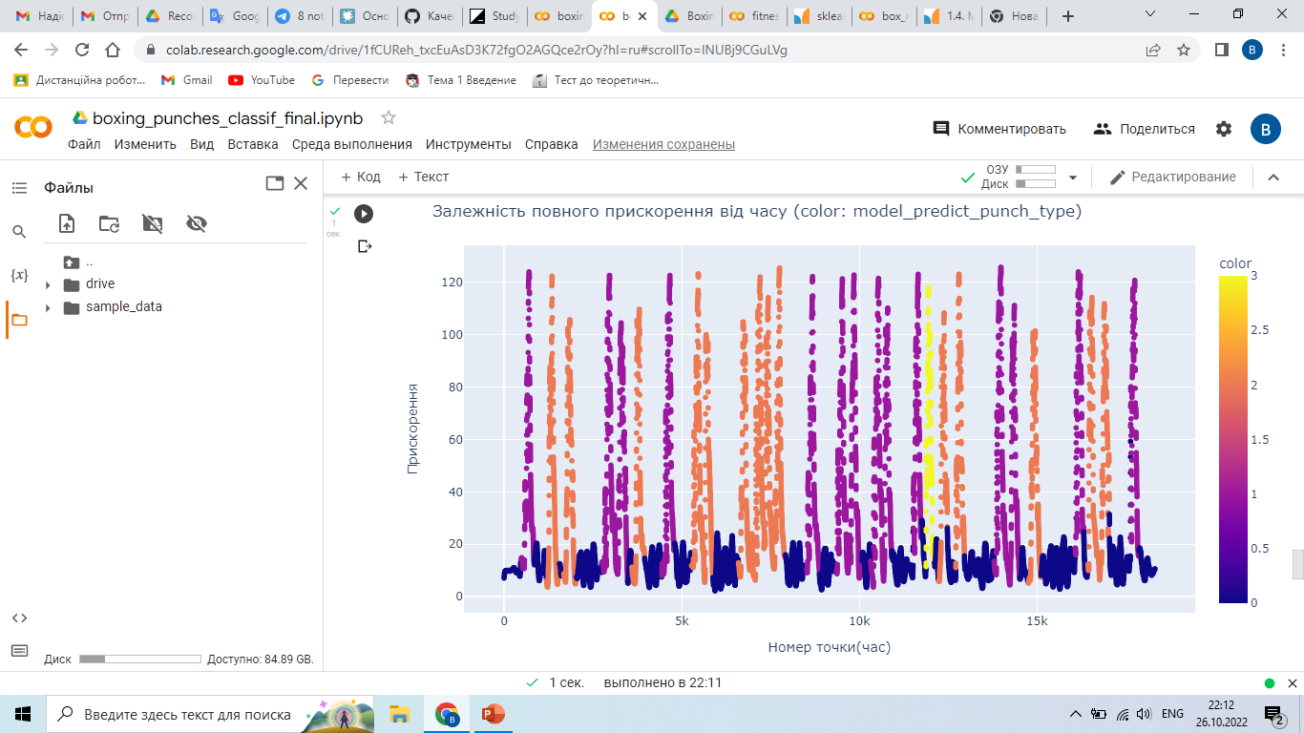
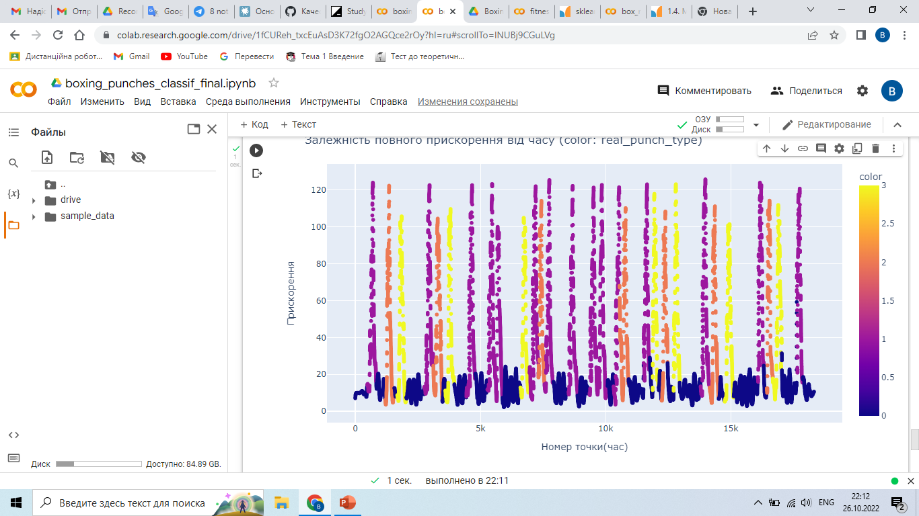

Slide 30
Conclusion
A model that can classify the boxers punches of during a training fight was created. For that, data of about 800 beats and 15 minutes of combat were collected using an accelerometer and a gyroscope. Two well-functioning models have been created, the first classifies the blows, and the second detects them in the record. After that, they were combined into one model that performed its task well, but with a slightly lower result than the components of the model (accuracy = 0.84, precision = 0.98, recall = 0.97).
The deterioration in model running can be explained by the mixing of the shocks stat features because of the non-ideal clipping of the shocks by the second model.

Slide 31
Thank you for your attention!!!

